Slide 1
Unit 4: What do you want?

Slide 2
fly
a hot dog

Slide 3
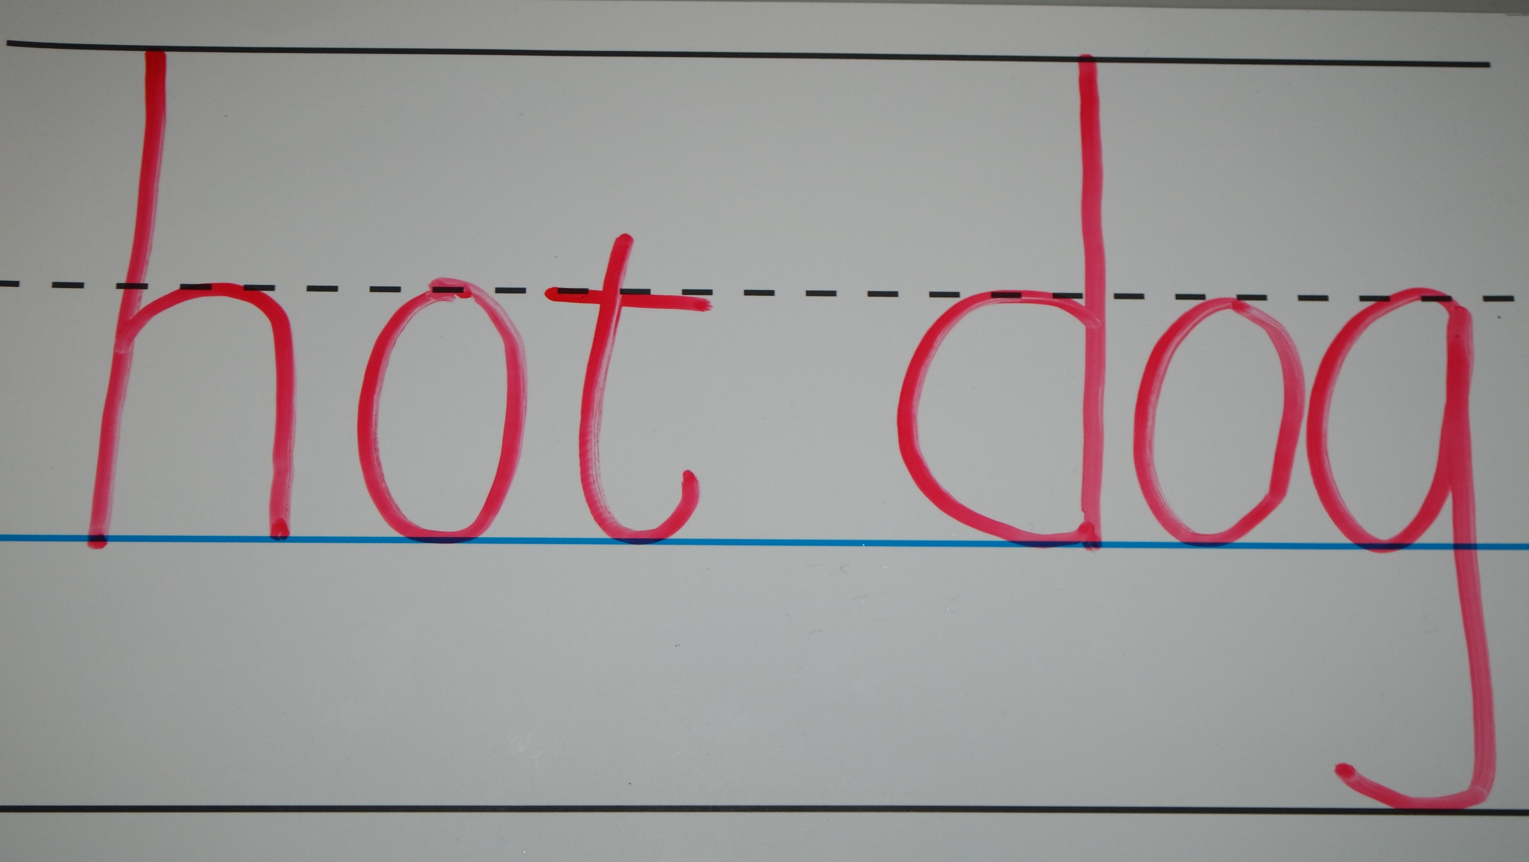

Slide 4
jump
an egg

Slide 5
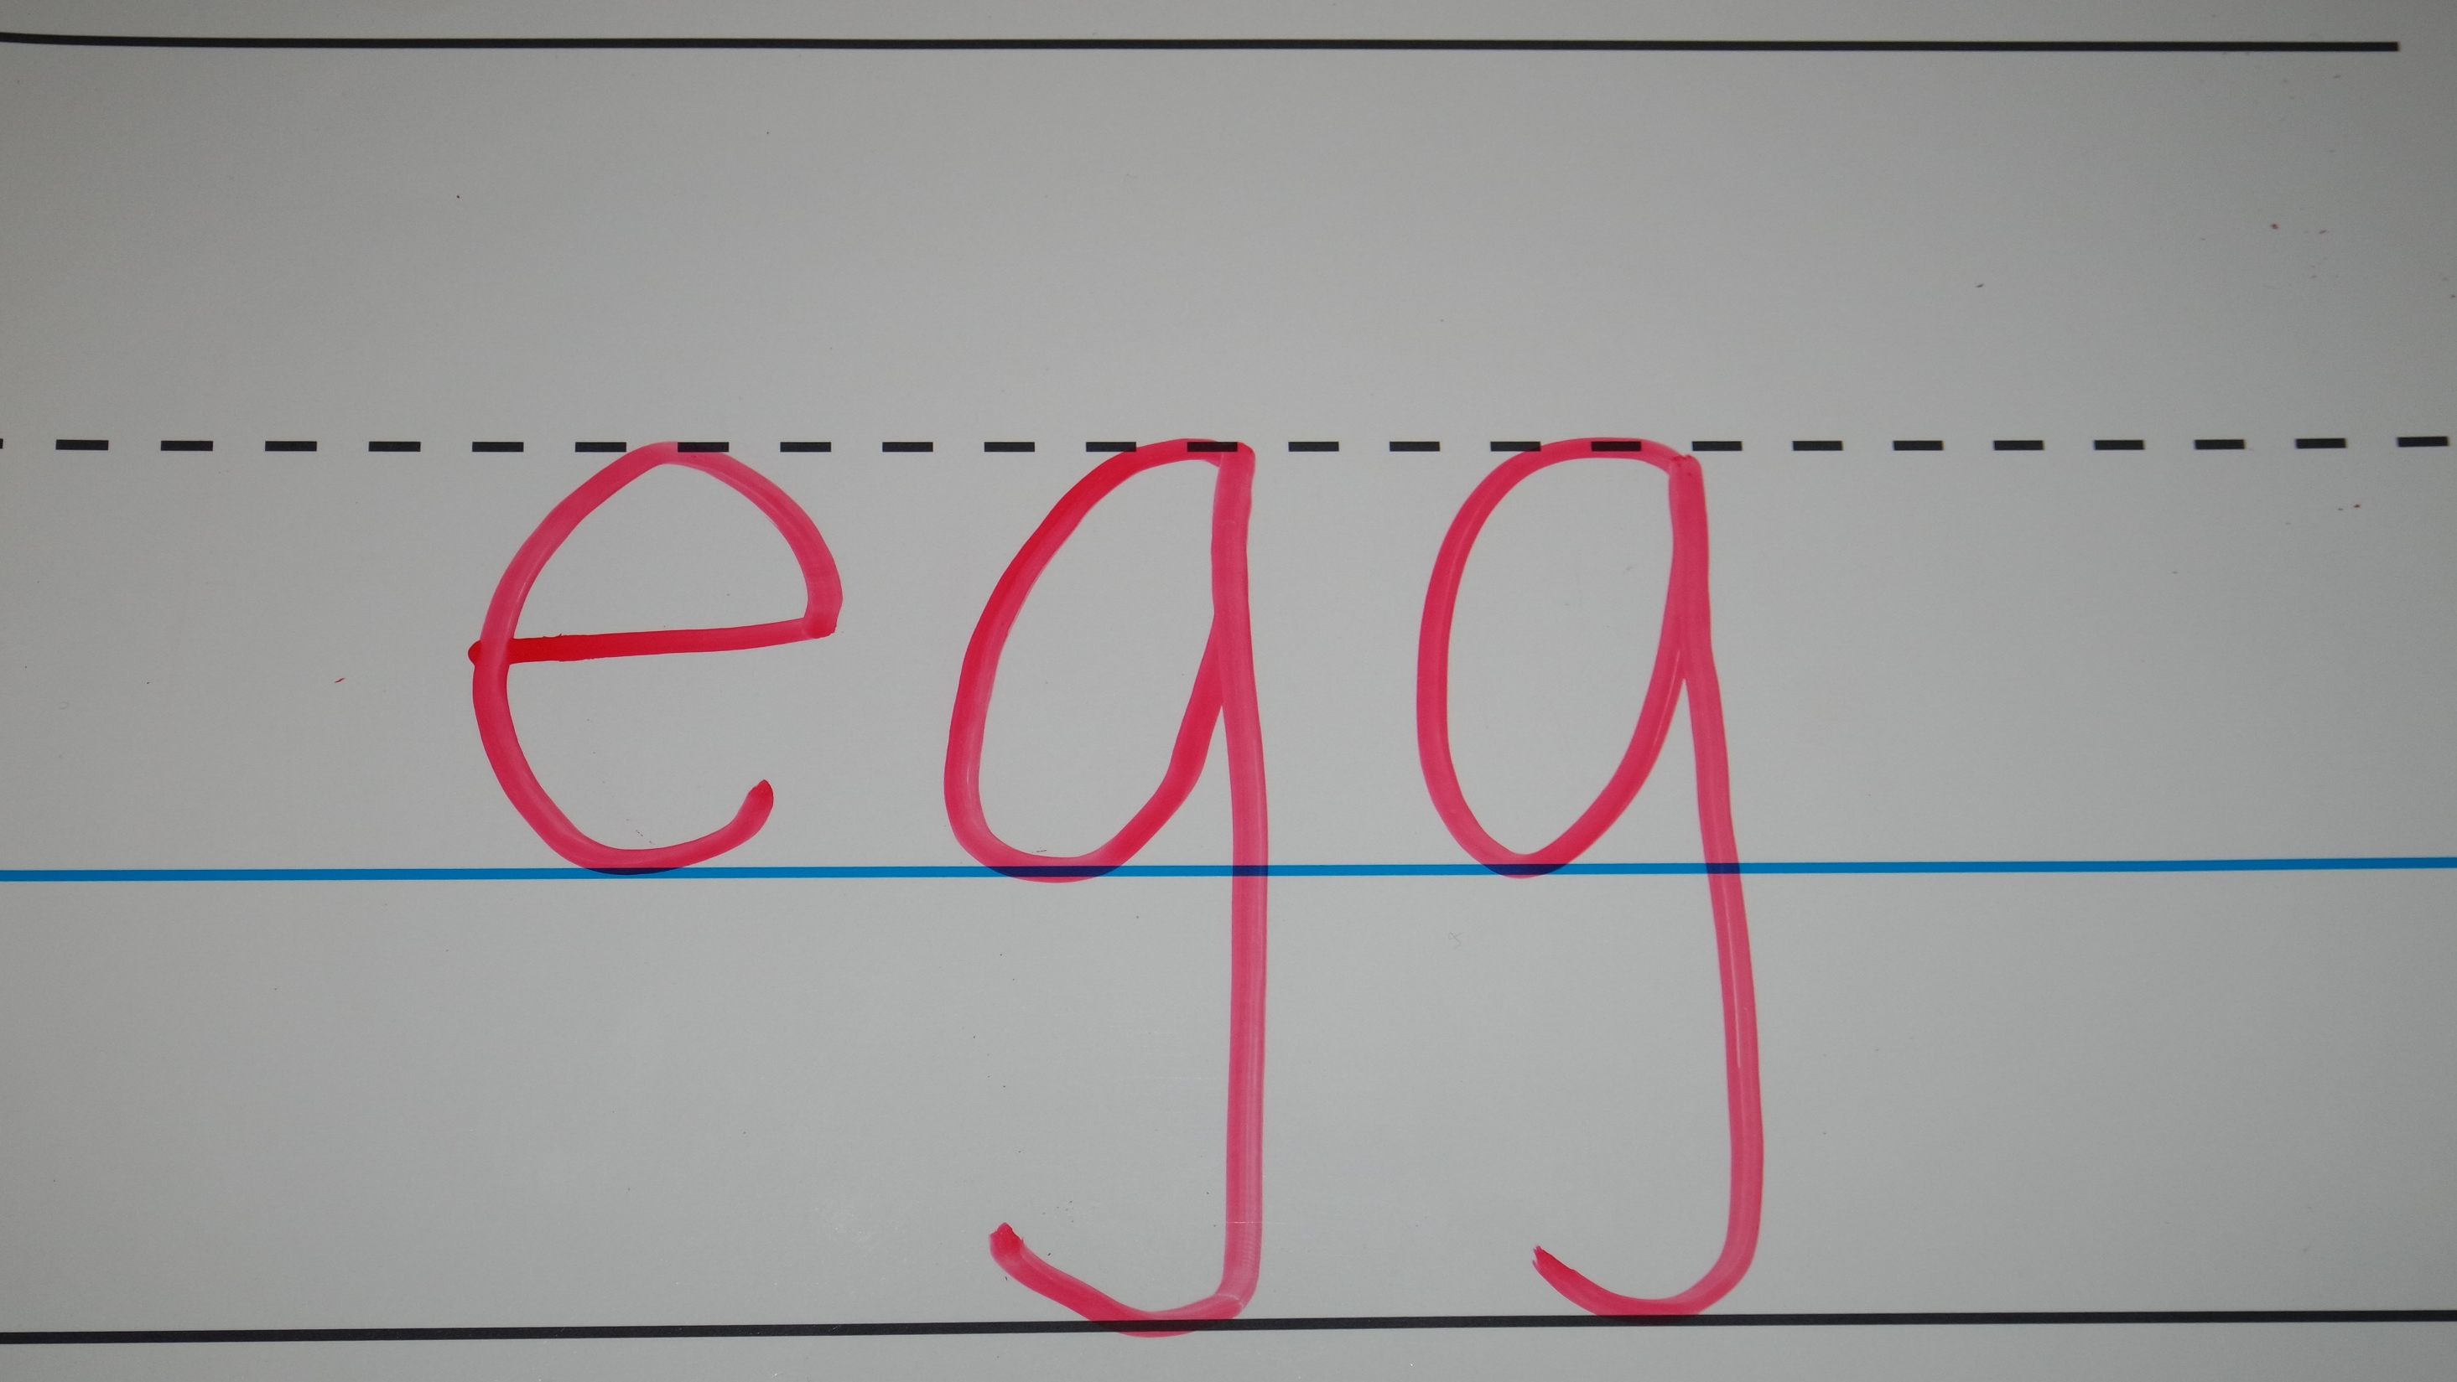

Slide 6
swim
a cupcake

Slide 7
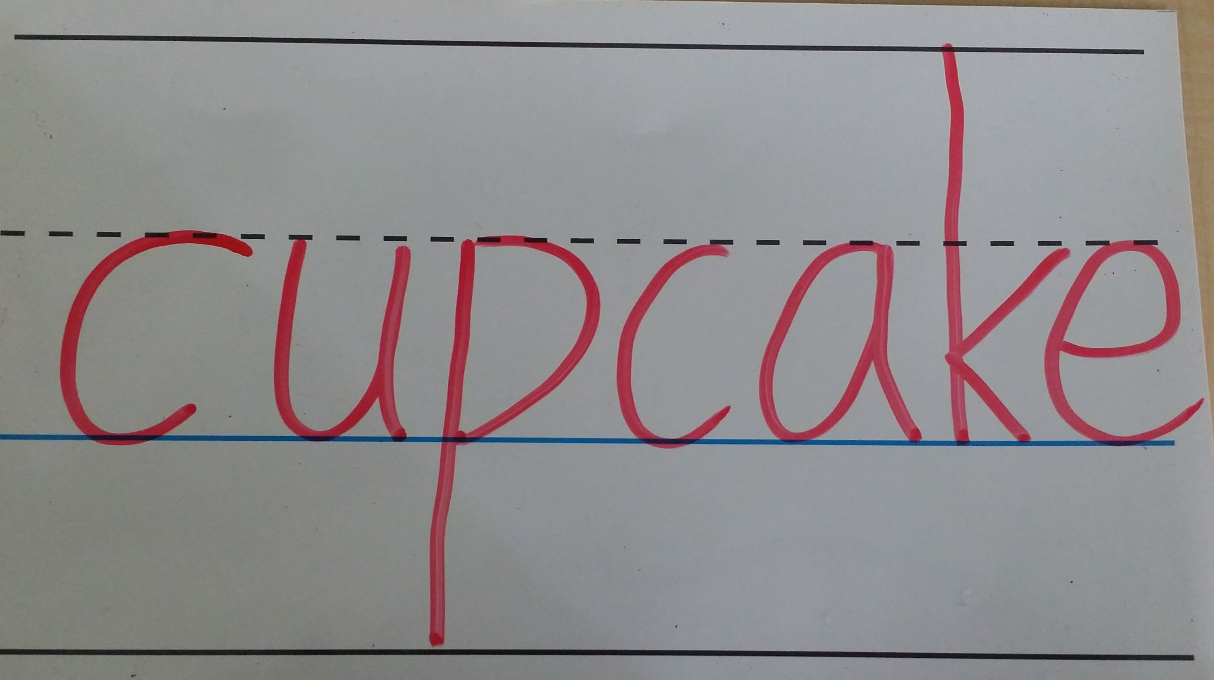

Slide 8
sing
bread

Slide 9
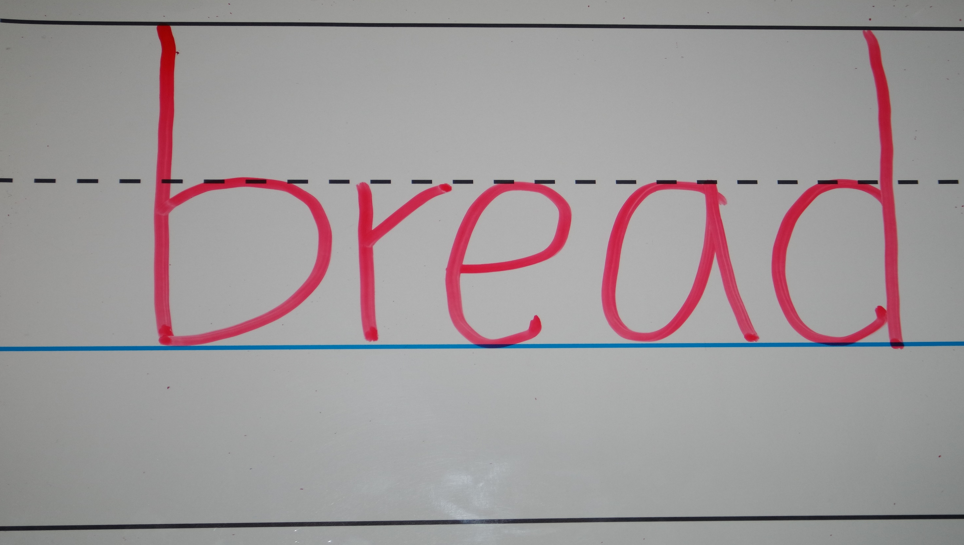

Slide 10
sing
juice

Slide 11
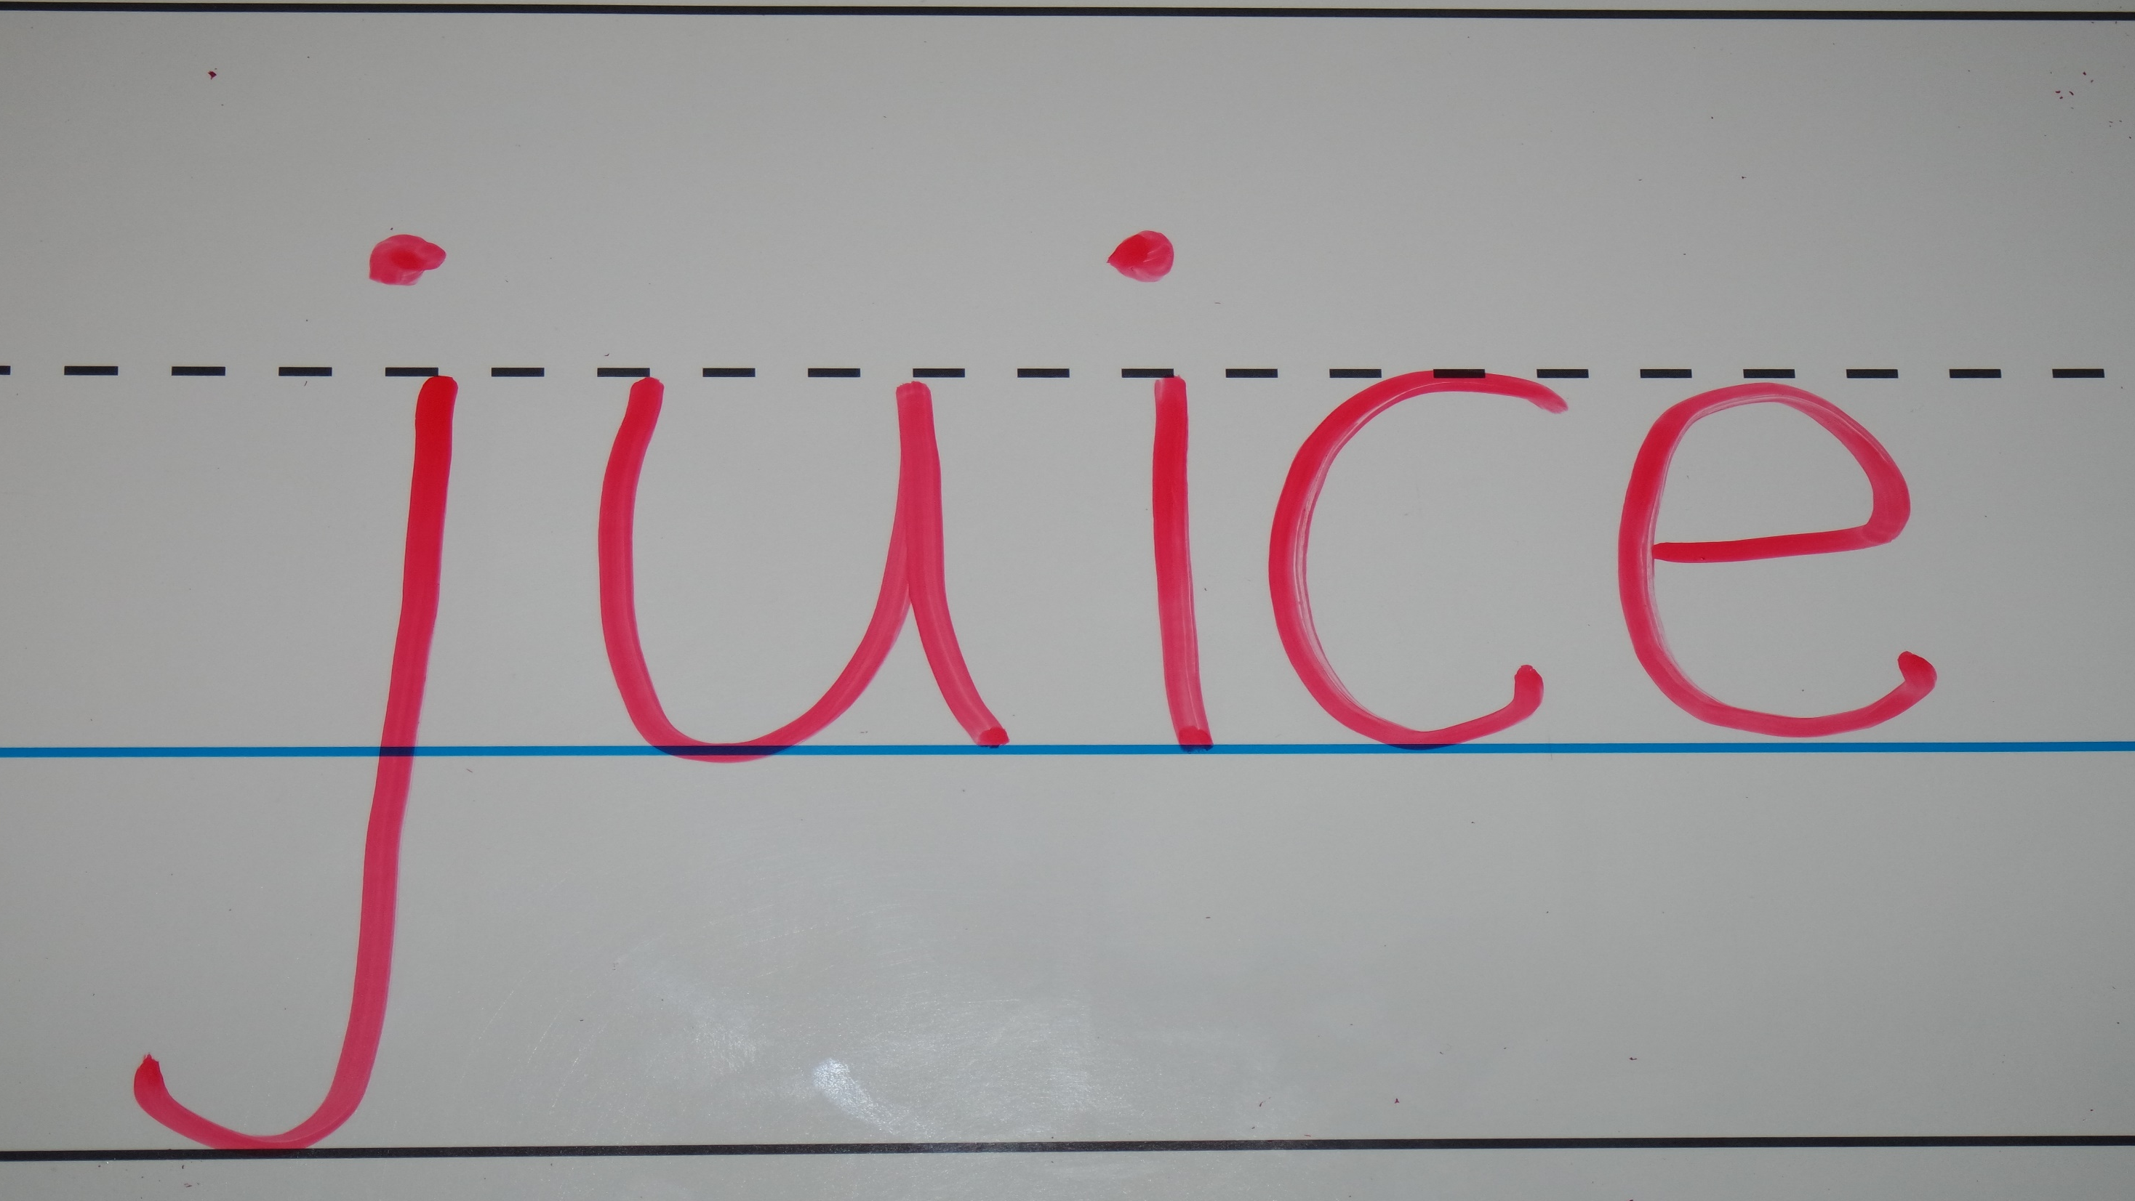

Slide 12
swim
milk

Slide 13
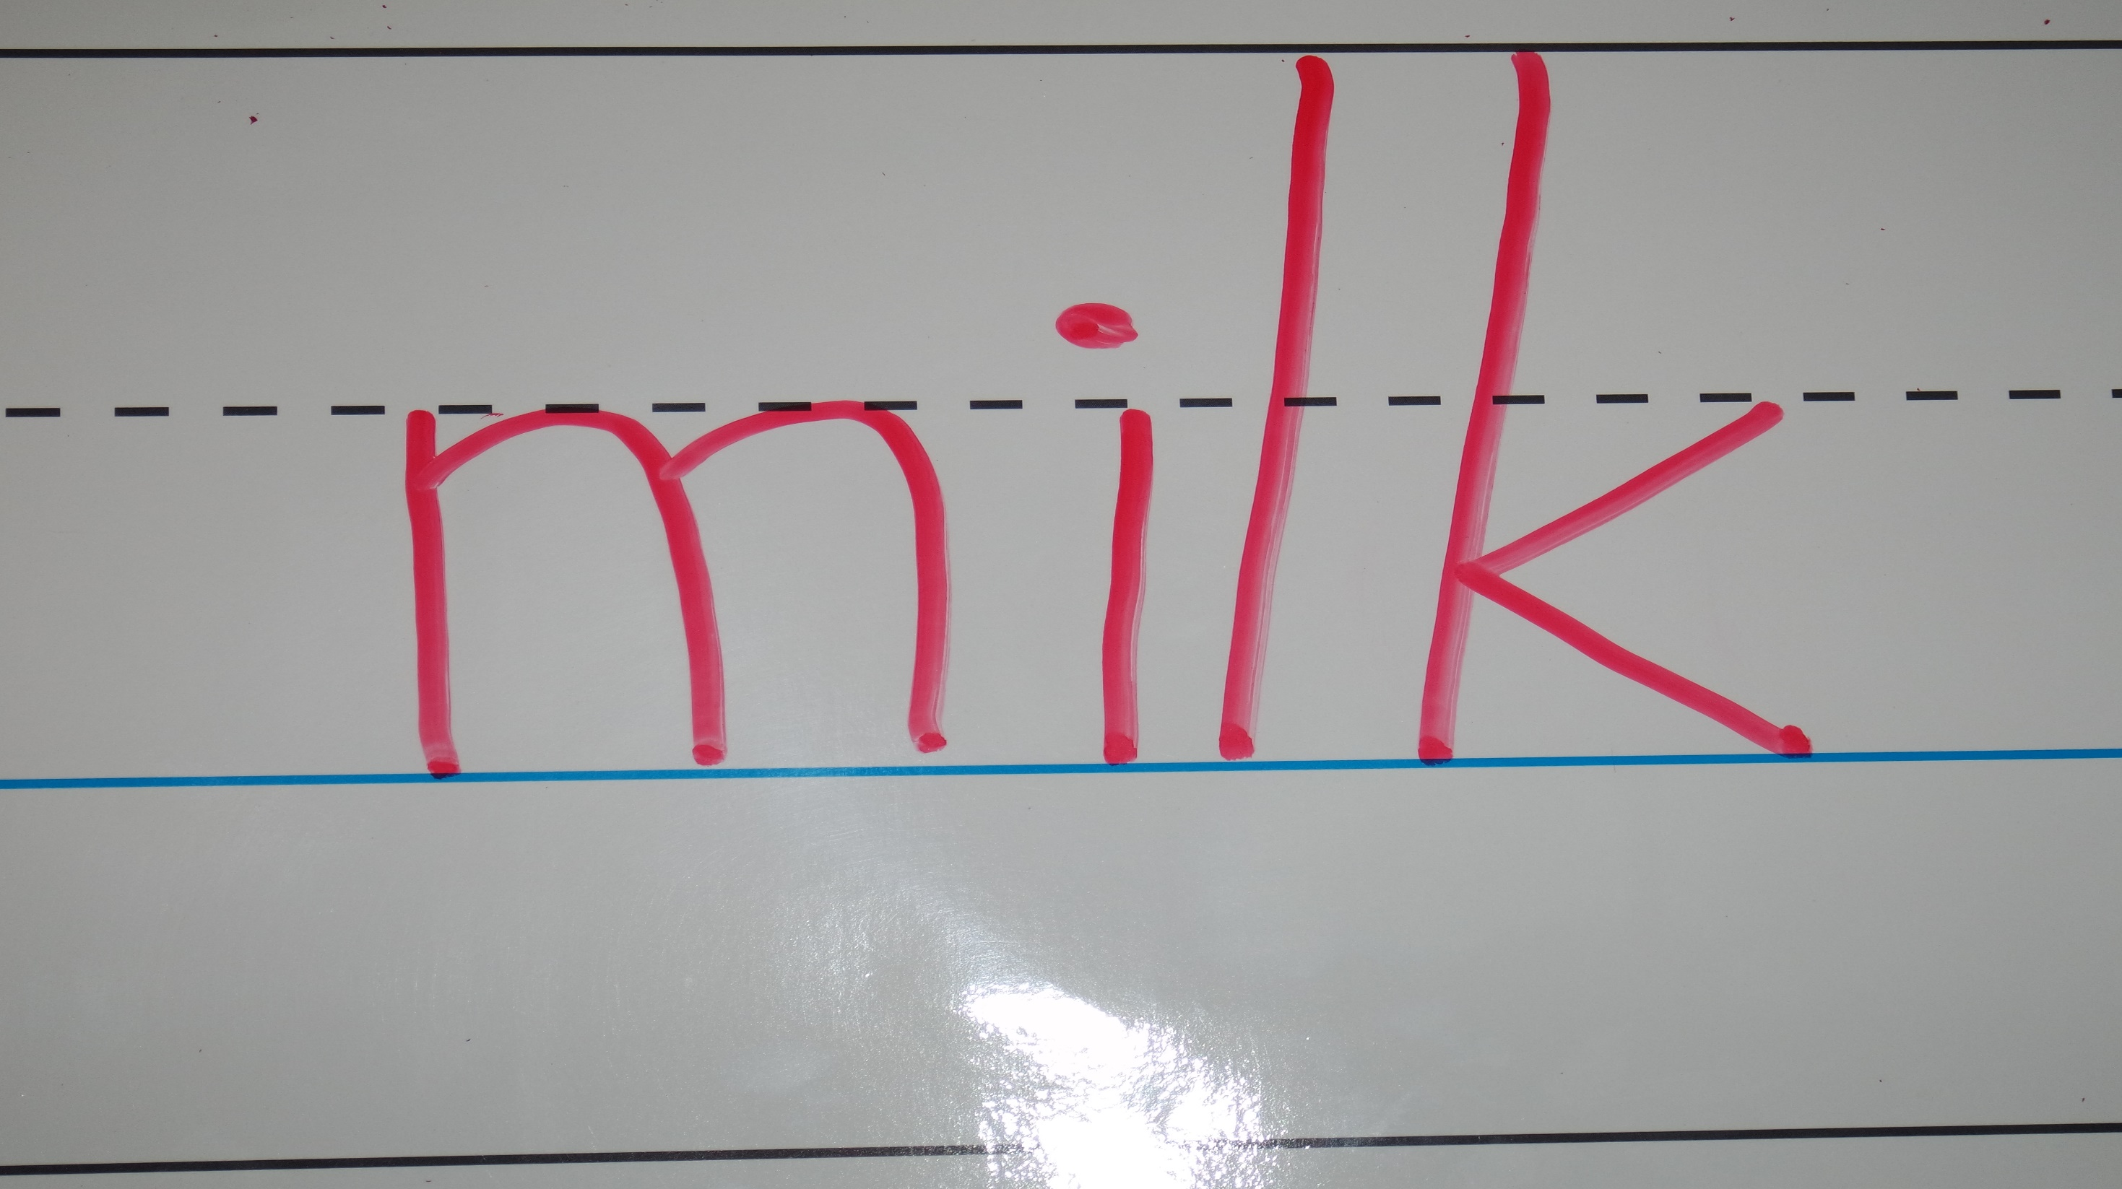

Slide 14
swim
tea

Slide 15
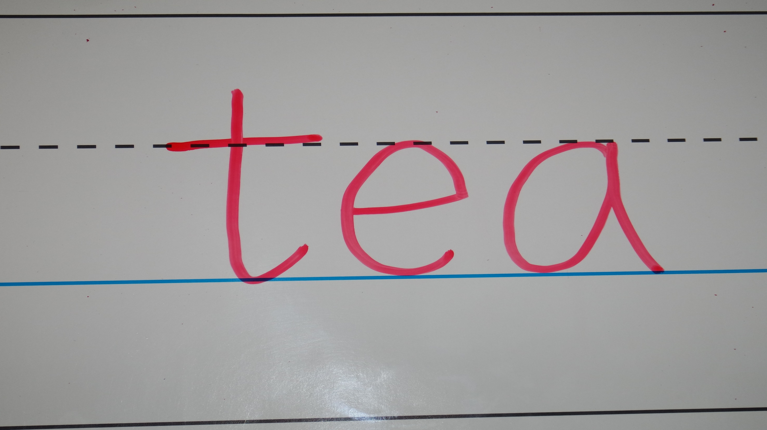

Slide 16
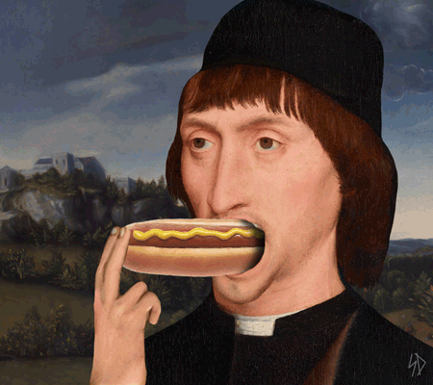
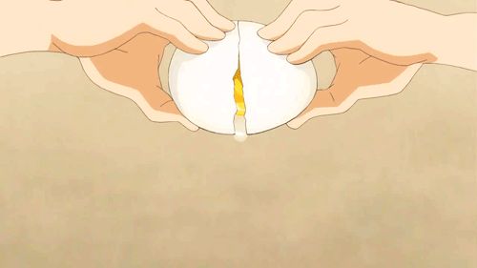
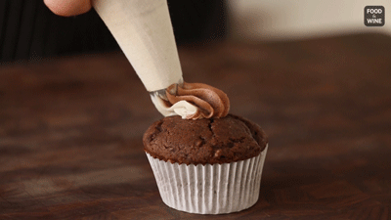
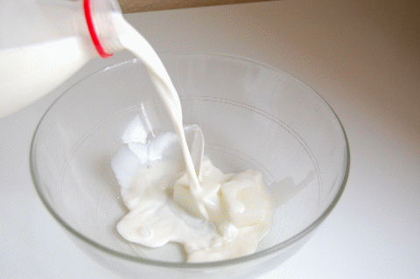
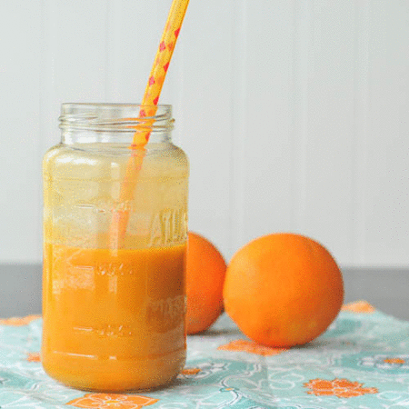
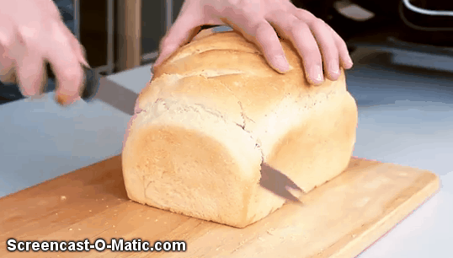
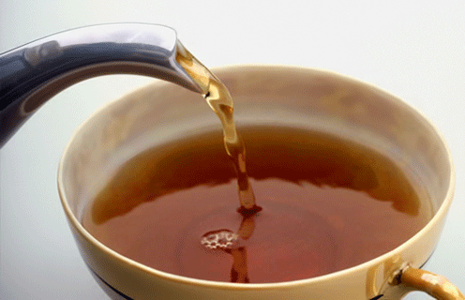
2
1
3
6
5
7
4

Slide 17
Pass the flashcards!

Slide 18
Homework this week
聽Listening:CD2(第24~28首)，每聽3遍請家長簽名。
說Speaking:聽CD時跟著大聲唸，加強句型。
寫Writing:英文作業本，完成單字練習，下週一交。

